Slide 1

BUILDING A BRIDGE BETWEEN
API OWNERS AND CONSUMERS
Taija Björklund 22.9.2015 MindTrek 2015

Slide 2


CENTURY OF DATA?
11011011
10011110
10111010
11001101
10001111
10100110
00000101
00001110
11001011
10011000
10101010
00001101
10001111
10100110
01010101
00001110
01011011
11011110
00111010
11001101
10001111
10100110
10010101
00001110
19th century
20th century
21st century
Notes:
Open data and APIs
19th century: all about mining (gold, iron, other metals)
20th century: all about drilling (oil, natural gas)
21st century: mining of a different kind: data.
Big data, smart data, small data, open data, my data, IoT

Slide 3
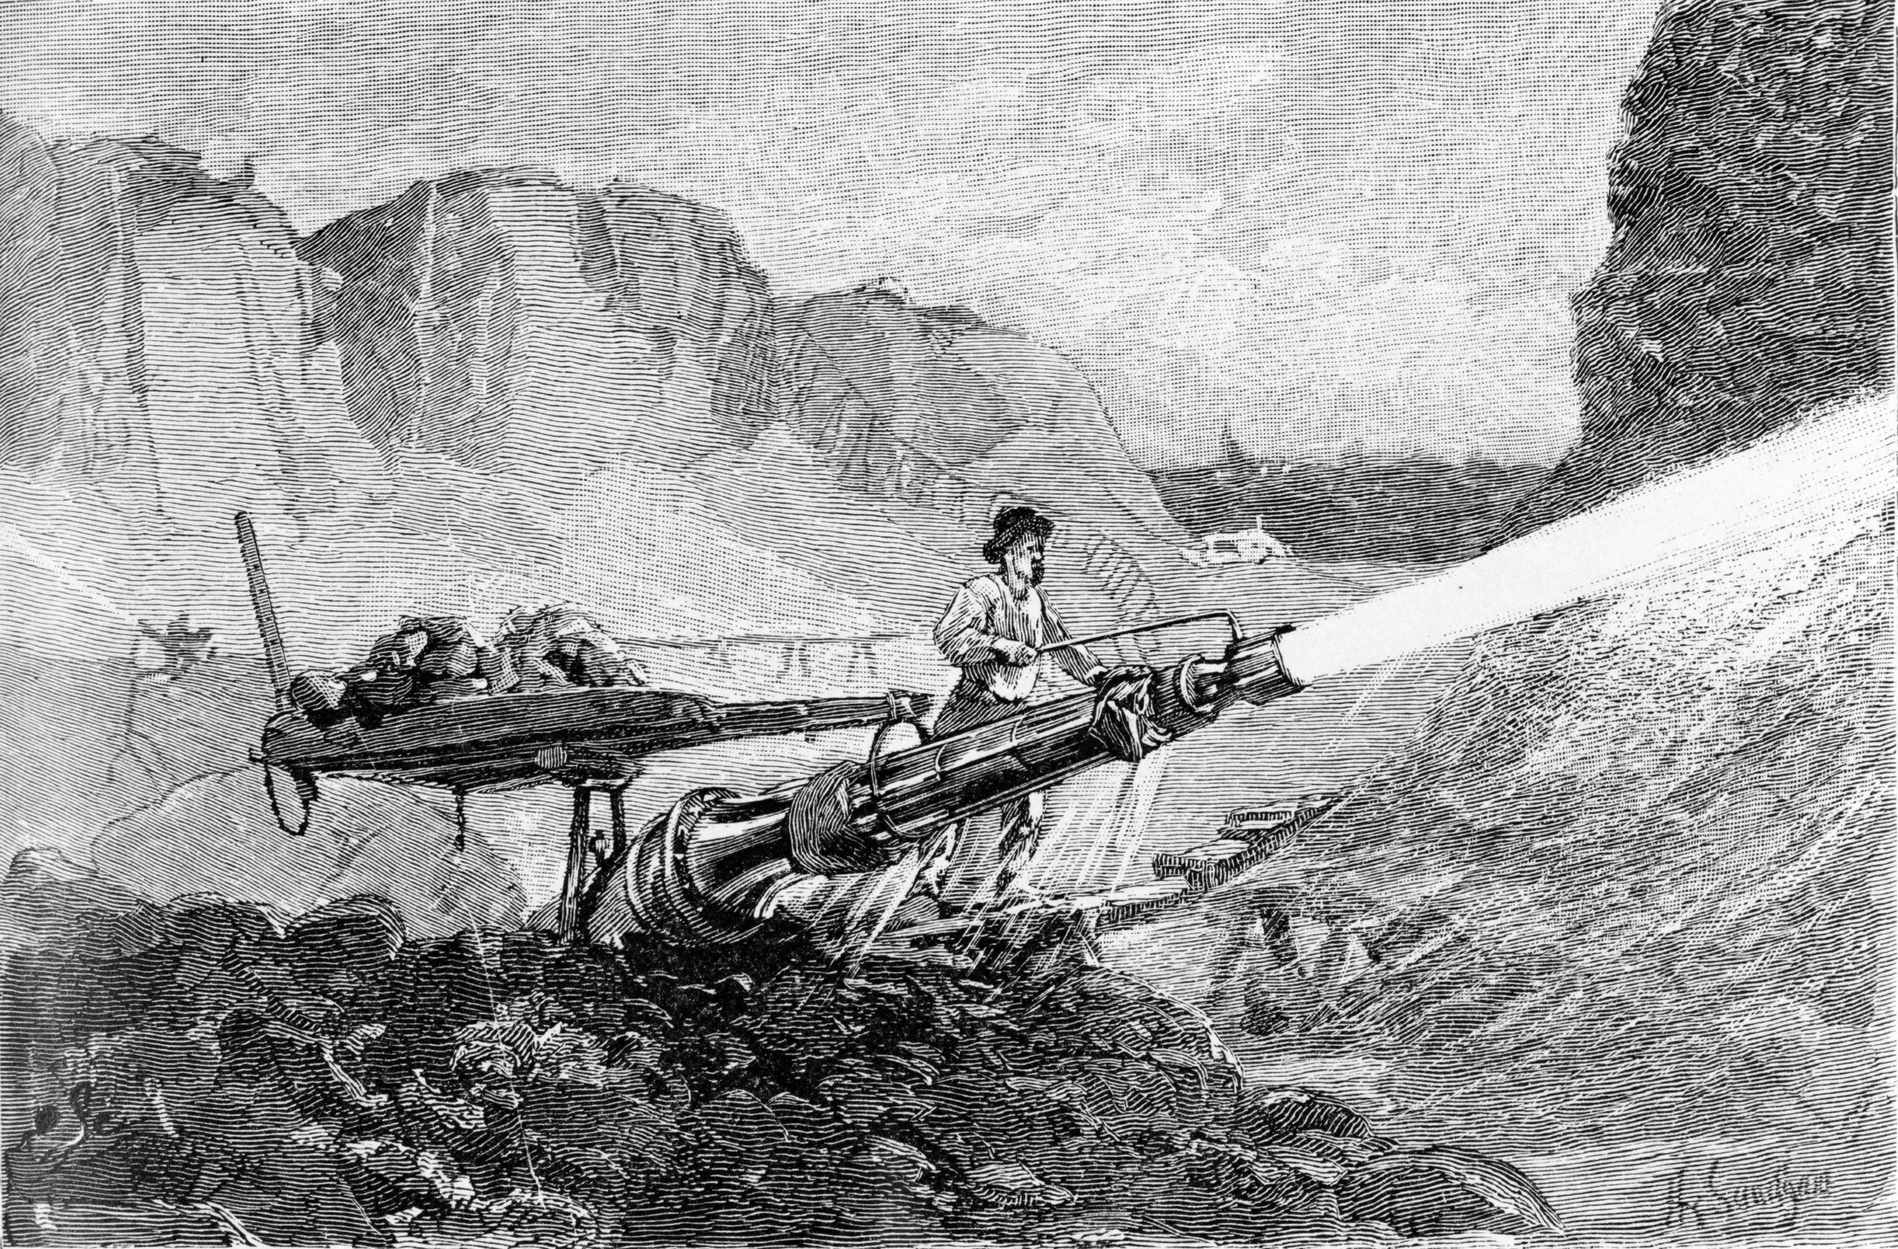
Notes:
Use data responsibly
Hydraulic mining in California:
California Gold Rush
using pressurized water jets (1850s )
successful in extracting gold-rich minerals
resulted in extensive environmental damage, e.g. increased flooding and erosion, sediment blocking waterways and covering over farm fields.
Doing a task at hand in good faith

Slide 4
API – the digital middle man
Notes:
It’s not enough for the data to just be there, it needs to be accessible, understood, shareable.
APIs are the digital middlemen = provide interaction between data and applications utilizing the data
APIs also imply a 'contract'. (API will change in a predictable manner.)

Slide 5
API TYPES
OPEN API
PARTNER API
CLOSED API
Innovation
Cooperation
Agility, control
Notes:
- Open APIs = public APIs, released publicly,
available for anyone to register for a key, and start programming against.
Crowdsourcing innovation, larger workforce -Partner API > allows for cooperation between organizations
- Closed, enterprise / intenal API: can provide agility inside the company
The API will not be made publicly available and will be tightly controlled
> you can get your feet wet with API deployment, gain experience, before opening APIs

Slide 6
”
What is intriguing for us is to see what citizen-generated innovation can tell us about our data that we didn’t know, what incredible insights are embedded in our data that we didn’t know. What is the second, third, fourth, fifth use of this data?
(http://www.programmableweb.com/news/nasa-launches-api-portal-to-encourage-use-data-sets/2015/05/26)

Slide 7
USER ROLES
API OWNER / PROVIDER
API CONSUMER
API manager
Developer

Slide 8
DEVELOPER EXPERIENCE (DEX)
3:30:3
understand
find endpoint
start consuming
Notes:
3:30:3 rule by Ori Pekelman:
make sure that any developer doesn’t take more than 3 seconds to understand what your API does / what is the purpose of your API, 30 seconds to find/identify the correct endpoint and 3 minutes to start consuming it"

Slide 9
API LIFECYCLE
Design
Develop
Deploy
Revision
Retire

Slide 10
API PROXY MODEL
Proxy
APP
API

Slide 11
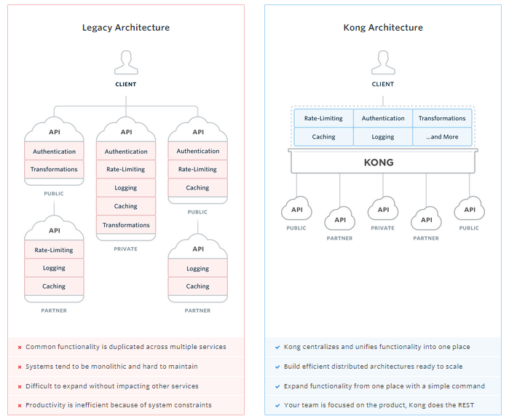
Source: https://getkong.org/
Notes:
From Kong, open source API management tool

Slide 12









BENEFITS FOR THE API OWNER AND MANAGER
Existing platform
API user authentication
Visibility for your API
Simplicity for managing APIs
Visual insight into API usage (patterns)
Response caching
Rate limiting
Own infrastructure or ours
Can be whitelabeled / re-branded (roadmap)
Notes:
API Umbrella as foundation, added value for end-users, human-centered approach
”API Umbrella on steroids”
Managers have simplified workflow for common tasks, such as key management, rate limiting and viewing API usage analytics.

Slide 13





BENEFITS FOR THE API CONSUMER
Visual insight into API key usage
Mixing API sources (roadmap)
Checking API status
Rich documentation
Producing sample code from documentation
Notes:
For developers APInf provides simple key management, key usage analytics and API discovery along with API documentation.
More insight into app usage

Slide 14
TECHNOLOGIES IN APINF
D3.js
Bootstrap
Leaflet
Meteor.js
nginx
Mongo
GNU / Linux
Swagger
API Umbrella
Swagger UI
Swagger Editor
Node.js
Rails
nginx
Elastic
GNU / Linux
Notes:
State of the art open source technologies

Slide 15
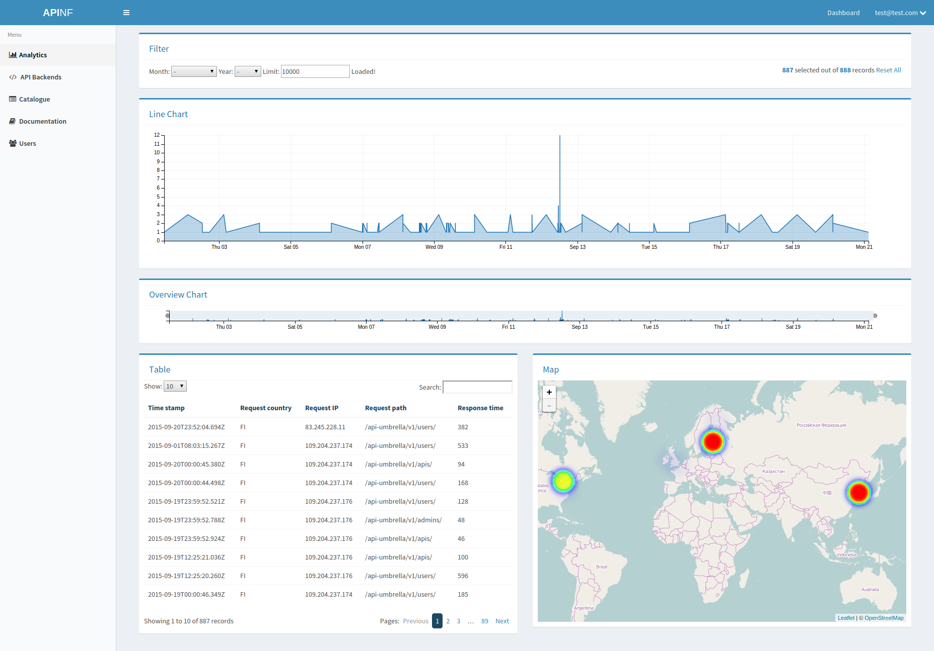
Notes:
Adding a dashboard on top of API Umbrella: gives your situation awareness of your API.
The analytics on the dashboard allow both managers and consumers to view usage statistics by time, location – you can zoom into a particular time. All charts and maps are updated when you interact with them.

Slide 16
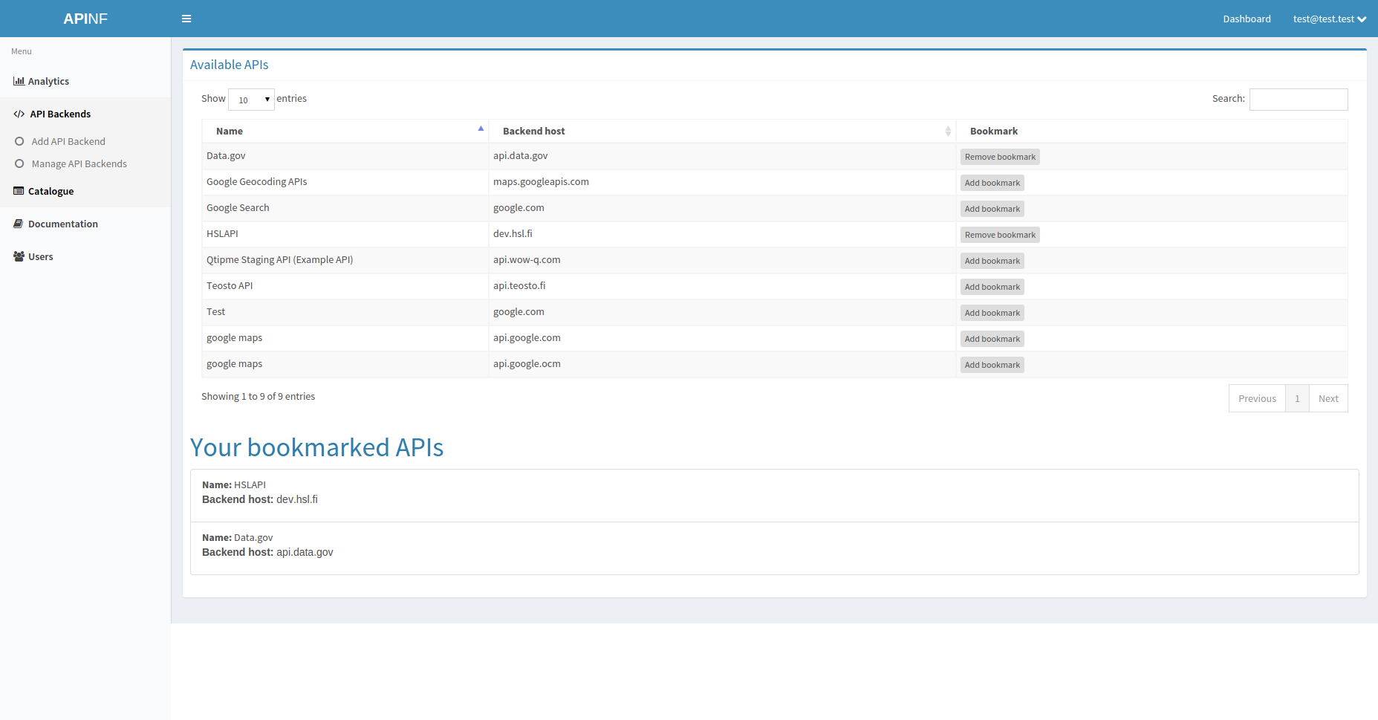
Notes:
API catalogue: discovery and memory: find and bookmark interesting APIs

Slide 17
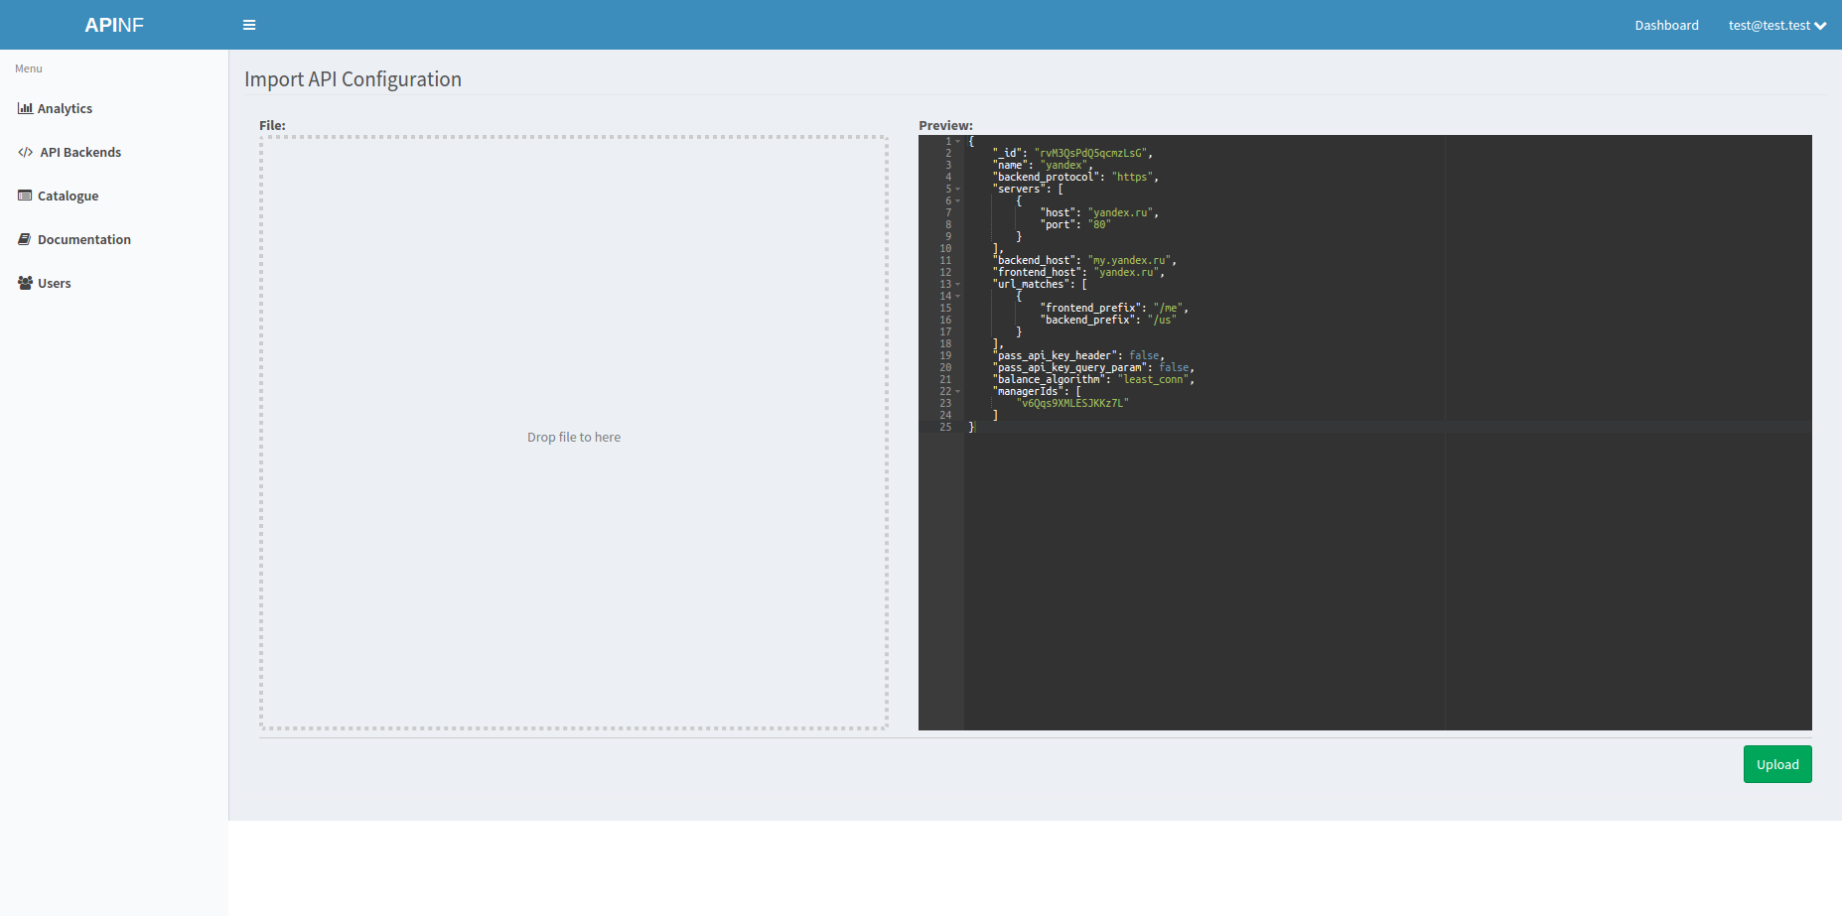
Notes:
Simplicity: you can import yaml, json configuration files by dragging and dropping
(yaml and json strive for simplicity, standard and common formats)

Slide 18
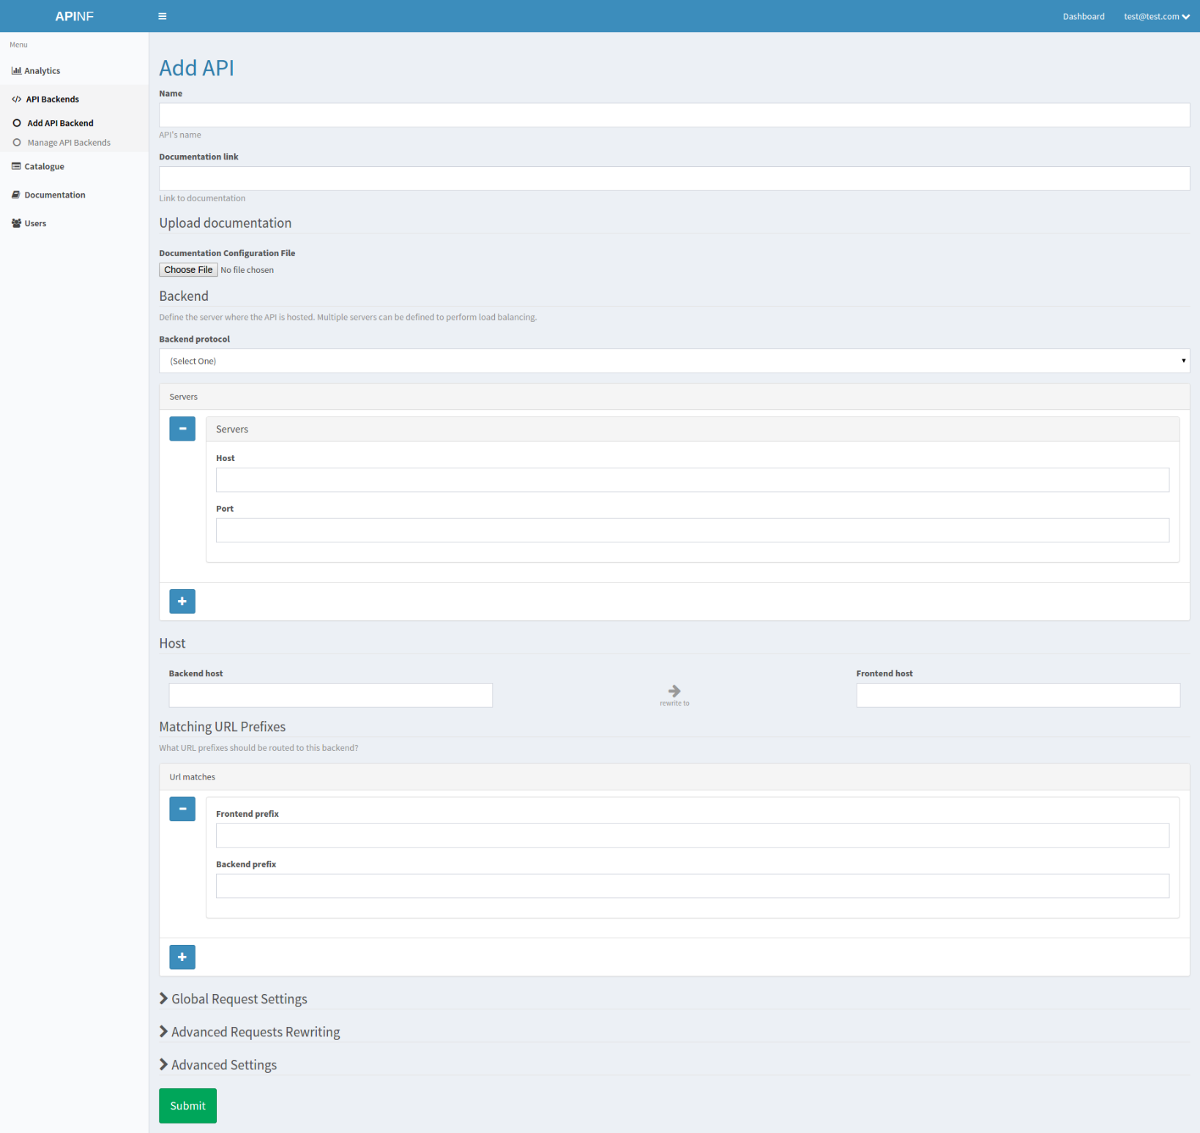
Notes:
Or you can add an API endpoint through a configuration form.
Optional fields have been hidden for simplicity.

Slide 19
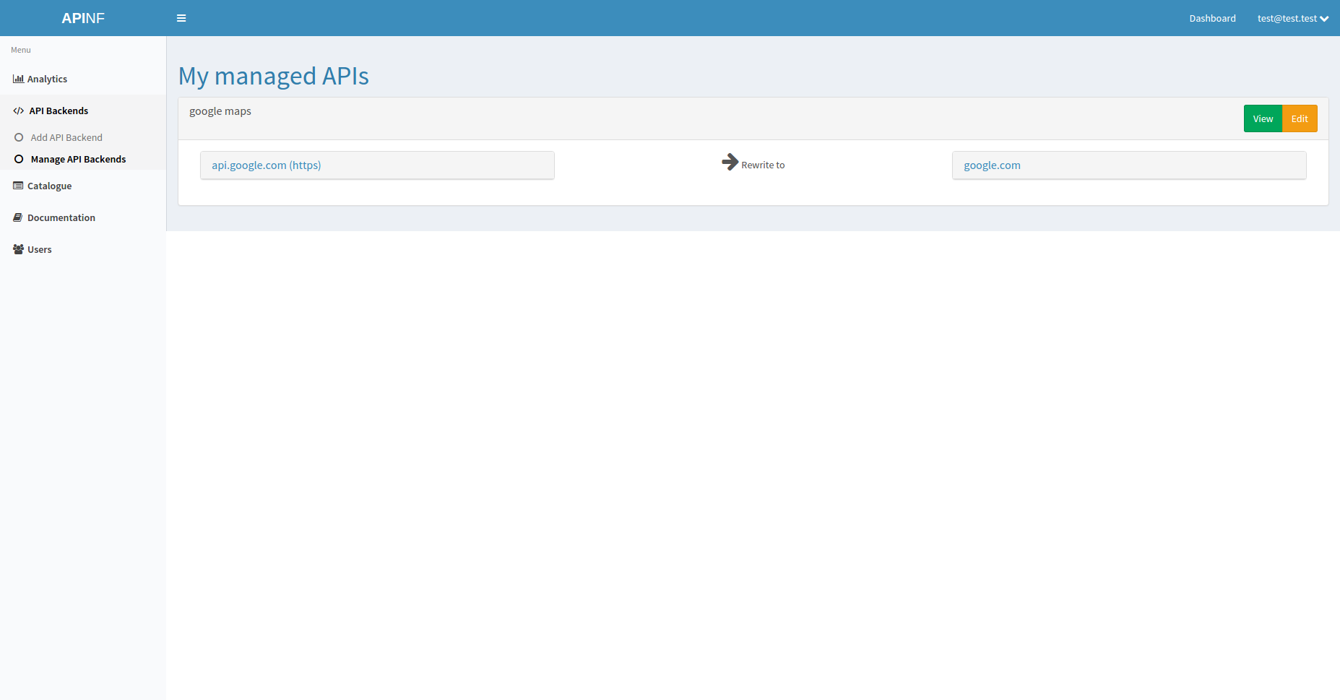
Notes:
For API managers, we offer a view of their managed APIs. Overview + possibility to view and edit

Slide 20
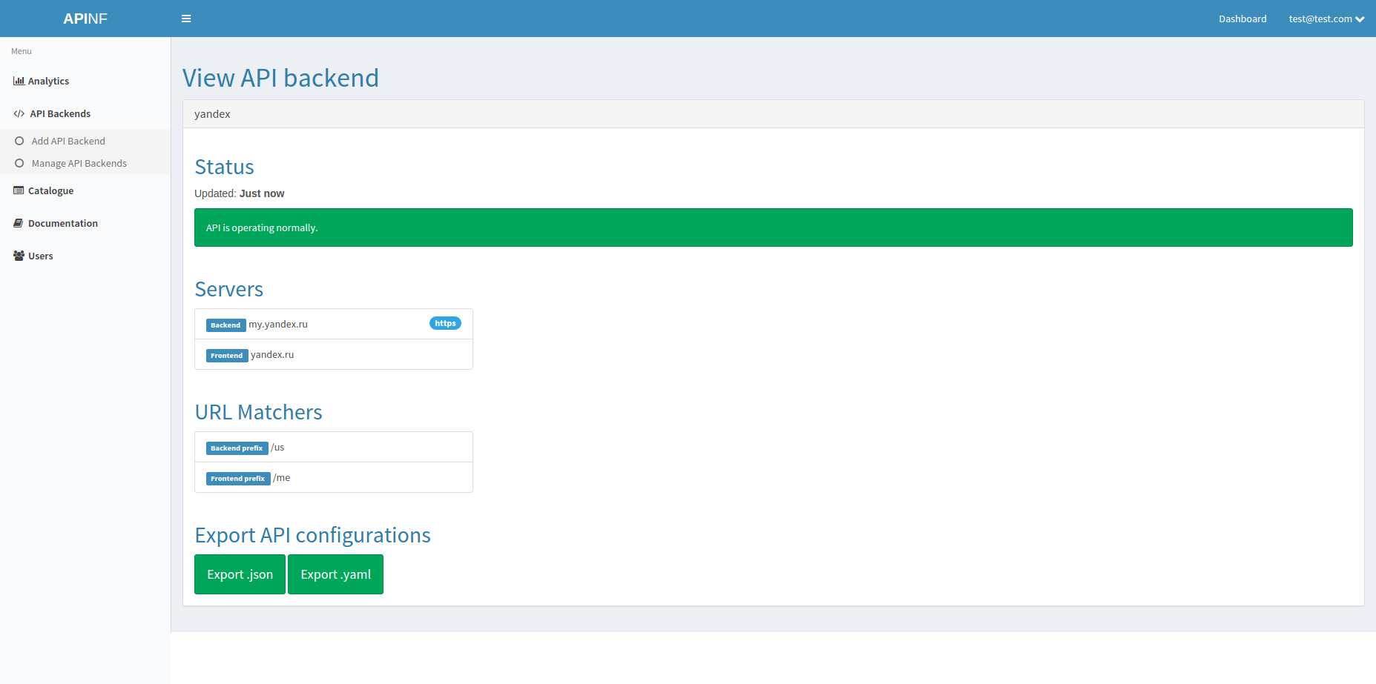
Notes:
View API backend
See at a glance
Check api status
export API configurations

Slide 21
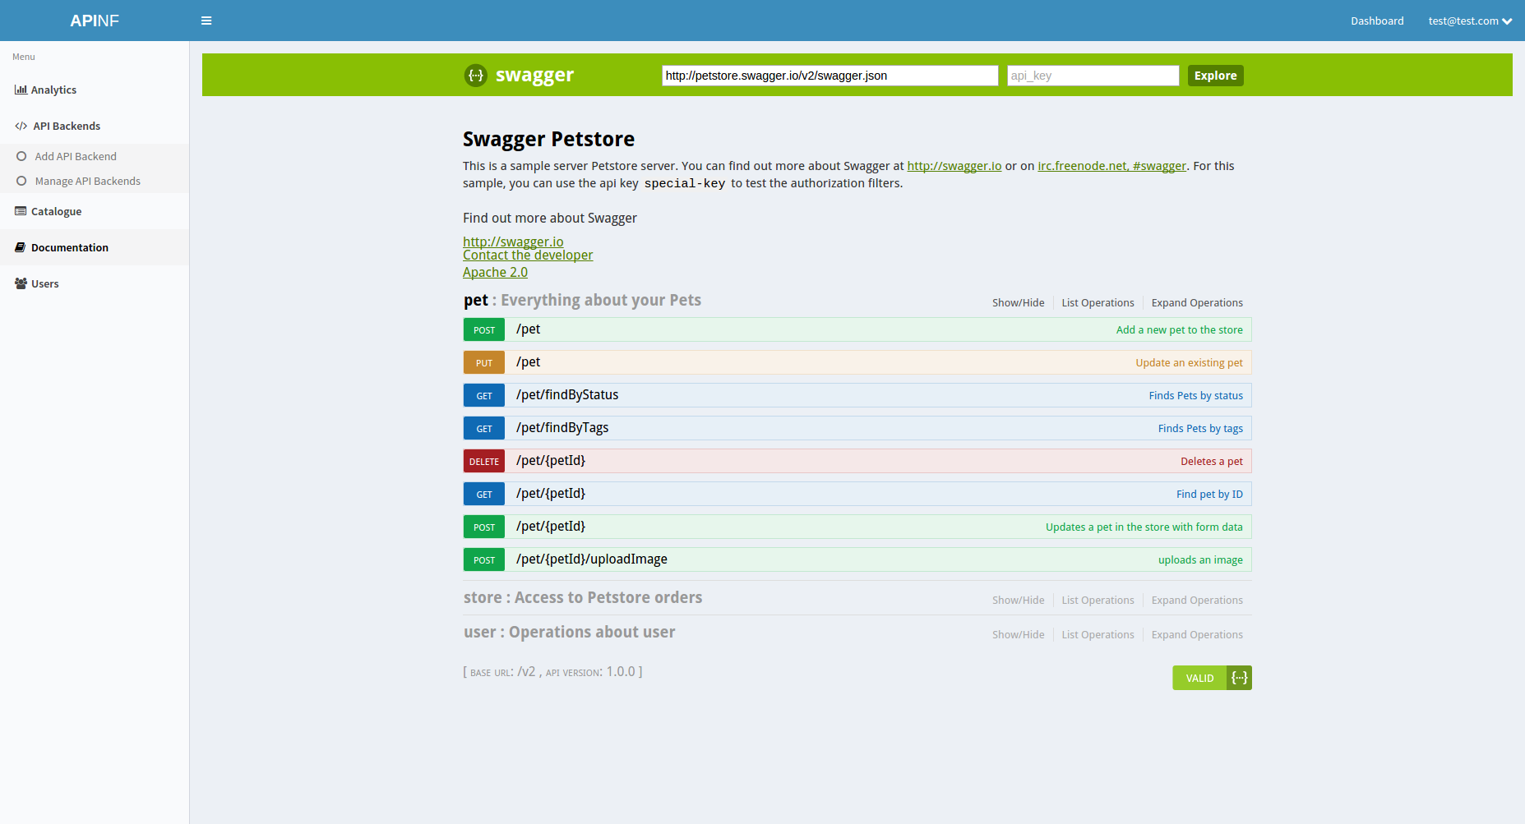
Notes:
Swagger viewer
Understanding the api
Testing the api
Swagger editor
Creating api documentation
creating SDK’s
Create server scaffold

Slide 22


Notes:
Core team, responsible for all development of Apinf
All open source. Transparent processes: you can even view our backlog, scrum board and scrum meeting minutes online

Slide 23

API backlog
Tighter integration to Swagger
Federation
Dashboard improvements
Whitelabeling
Mixing API sources
Notes:
Roadmap: Selected features from Apinf backlog

Slide 24
OPTIONS
Apinf as free tool
Apinf as service
Full API management tool
Analytics
Cloud or self-hosted
Community supported
Hosting
Initial setup and installation support
Whitelabeling / re-branding
Custom development
Technical support
Consultation and API training
Notes:
If you need API management, just get it from Github, install it and let us know how it went. If you think it’s too much hassle, let us know and we will help. Or if you have just one API, just use our proxy at apinf.io, it’s free.

Slide 25
MORE INFORMATION
https://apinf.io/
http://community.apinf.io/
https://www.facebook.com/APInf.io
https://twitter.com/APInf_io
https://github.com/apinf/api-umbrella-dashboard
https://github.com/apinf/docs
Notes:
Find the beta version from apinf.io

Slide 26
THANKS! Any questions?
Contact me at taija.bjorklund@apinf.io

